Slide 1
K means algorithm accelerator
Project by:
Liora huf
Edi Sraiber

Slide 2
Introduction
Introduction to K means algorithm
Problem definition
Possible solutions

Slide 3
K means algorithm Intro
Clustering is the classification of object in different groups, or more precisely, the partitioning of a data set into subsets(clusters), so the data in each subset(ideally) share some common – often according to some defined distance measure.
K means algorithm is a algorithm develop to determine all the clusters at once of a data set

Slide 4

Common distances measures
Distance measure will determine how the similarity of two elements is calculated and it will influence the shape of the cluster. Two common distances measures are:
The Euclidean distance and it is given by : $d\left(x,y\right)= \sqrt[2]{\sum_{1}^{n}{{\left|x_{i}−y_{i}\right|}^{2}}}$
The Manhattan distance and it is given by : $d\left(x,y\right)=\sum_{1}^{n}{\left|x_{i}−y_{i}\right|}$
The Manhattan metric performs faster than the Euclidean metric, because it does not require calculating the square, offering better exploitation of parallelism and speed twice than that obtained by Euclidean distance. However, the accuracy of this distance measure was found to be slightly inferior to the Euclidean metric, but results were still within an acceptable error.

Slide 5
K means clustering
The k means clustering algorithm is an algorithm to cluster n objects based on attributes into k partitions, where k<n.
K means clustering is a simple partition method for clustering analysis and widely use in machine learning.
Each clusters is represented by the center of the cluster and the algorithm converges to stables centroids of clusters.

Slide 6
K means algorithm
Given the cluster number K, the K-means algorithm is carried out in four steps:
Initialization: randomly setting the initial centroids.
Classification: assign each object to the cluster with the nearest centroid measured with a specific distance metric.
Centroid update: Compute new centroids of the clusters given the current partition.
Convergence check : Compare the new centroids calculated on previous steps with initial centroids. If they are as close as a small threshold constant, end the algorithm. Else, return to Classification step with the new centroids.

Slide 7
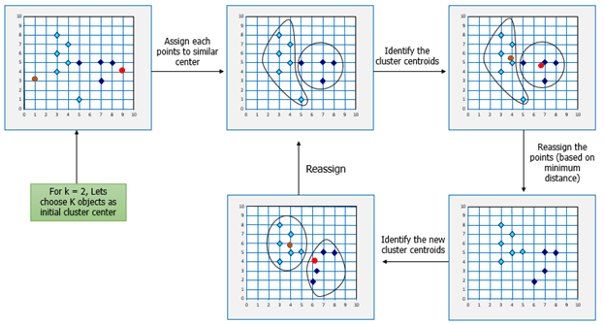

Slide 8
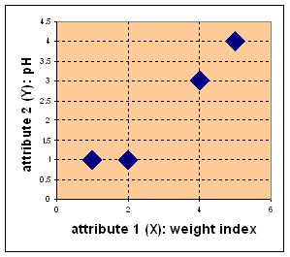
Example :
Suppose there are four type of medicine, each one has two attributes: weight and pH. The goal is to group these objects into K=2 groups of medicines.
Medicine | Weigh | pH
A | 1 | 1
B | 2 | 1
C | 4 | 3
D | 5 | 4

Slide 9
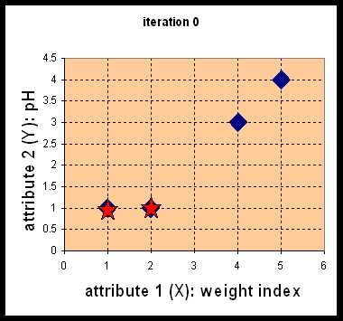

Example
Initialization: set the initial centroids randomly.
In this example, the initial centroids were set to be as the medicine A and B:$C_{1}\left(1,1\right),C_{2}(2,1)$

Slide 10

Example
$$d\left(D,c_{1}\right)= \sqrt[2]{{\left(5−1\right)}^{2}+{\left(4−1\right)}^{2}}=5$$
$$d\left(D,c_{2}\right)= \sqrt[2]{{\left(5−2\right)}^{2}+{\left(4−1\right)}^{2}}=4.24$$
…
$$D^{0}=\left[\begin{matrix}0 & 1 & 3.61 \\ 1 & 0 & 2.83\end{matrix}\begin{matrix}5 \\ 4.24\end{matrix}\right]$$
Each column in this matrix symbolize an object, row a centroid. The elements are the distances from the object to the centroids.
Classification : Calculate the distance of each object to the clusters centroid and assign it to the nearest cluster.

Slide 11

Example
Centroid update : compute the new centroids given the current partition.
$${C_{1}}_{new}=\left(1,1\right)$$
$${C_{2}}_{new}=\left(\frac{2+4+5}{3},\frac{1+3+4}{3}\right)=(\frac{11}{3},\frac{8}{3})$$

Slide 12

Example
Convergence check : verify is new centroids are equal to last iteration’s centroids.
$${C_{1}^{1}}_{new}≠C_{1}^{0}$$
$${C_{2}^{1}}_{new}≠C_{2}^{0}$$
Return to classification step.

Slide 13

Example
Centroids after iteration 1 : $C_{1}^{1}=\left(1,1 \right),C_{2}^{1}(\frac{11}{3},\frac{8}{3})$
Centroids after iteration 2 : $C_{1}^{2}=\left(\frac{3}{2},1 \right),C_{2}^{2}(\frac{9}{2},\frac{7}{2})$
Centroids after iteration 3 : $C_{1}^{3}=\left(\frac{3}{2},1 \right),C_{2}^{3}(\frac{9}{2},\frac{7}{2})$
The results show that : $C_{1}^{3}=C_{1}^{2} ,C_{2}^{3}=C_{2}^{2}$
The algorithm has achieved convergence.

Slide 14
Problem definition
The k means algorithm although simple, could take several iterations to converge. Furthermore, for large data sets, running the algorithm in software level (for example in Matlab) could result in large latency and consume a lot of resources from the processor.

Slide 15
Possible solution
The main solution for accelerating the running time of the algorithm and saving resources is to build an dedicated component in hardware level in order to handle the task.

Slide 16
The chosen solution - K means accelerator
The paper which is the base for this project, “FPGA Implementation of K-means Algorithm for Bioinformatics Application: An Accelerated Approach to Clustering Microarray Data” by Hanaa M. Hussain, Khaled Benkrid, Huseyin Seker, Ahmet T. Erdogan.
The motivation of the paper is the acceleration of the K means algorithm in order to process Microarrays which is a technique used in genome experiments to measure expression level of many thousands of genes simultaneously.

Slide 17
What has been accomplished
Study of the paper
Macro architecture planning
Micro architecture planning

Slide 18


Hardware implementation

Slide 19
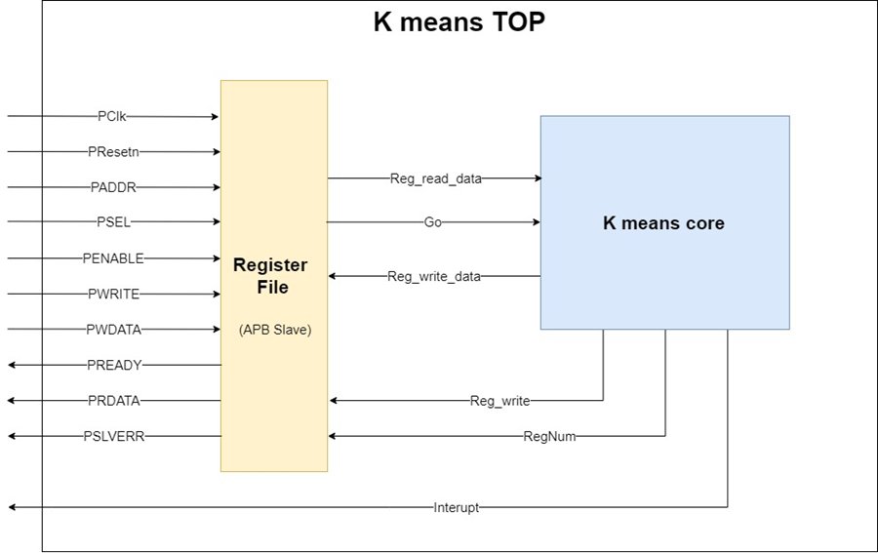
Proposed architecture
The high-level architecture proposed by this project is as shown in Figure attached. It is essentially composed of two main modules: the “Register file” and the “K means core”.

Slide 20
Proposed architecture – Register file
The “Register file” interfaces with the CPU host by APB protocol, as APB slave. Besides that, it also stores important data at local registers and interfaces with the second module “K means core”, allowing to read and write to its internal registers.

Slide 21
APB Protocol
The Advanced Peripheral Bus (APB) is part of the Advanced Microprocessor Bus Architecture (AMBA) protocol family. This protocol is a single master multi slave and set guidelines for transactions between the master and its low-bandwidth peripherals, the slaves. The APB protocol signal transactions are only related to the rising edge of the clock and every transaction takes at least two cycles. It can be used to provide access to the programmable control registers of peripheral devices. Furthermore, the APB is a low-cost interface that is optimal for minimal power consumption.

Slide 22
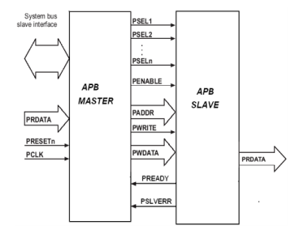
APB Protocol -signals
Signal | Source | Description
PCLK | Clock source | Clock. The rising edge of PCLK times all transfers on the APB.
PRESETn | System bus equivalent | Reset. The APB reset signal is active LOW. This signal is normally connected directly to the system bus reset signal.
PADDR | Master | Address. This is the APB address bus. It can be up to 32 bits wide and is driven by the peripheral bus bridge unit.
PSELx | Master | Select. The APB bridge unit generates this signal to each peripheral bus slave. It indicates that the slave device is selected and that a data transfer is required. There is a PSELx signal for each slave.
PENABLE | Master | Enable. This signal indicates the second and subsequent cycles of an APB transfer.
PWRITE | Master | Direction. This signal indicates an APB write access when HIGH and an APB read access when LOW.
PWDATA | Master | Write data. This bus is driven by the peripheral bus bridge unit during write cycles when PWRITE is HIGH. This bus can be up to 32 bits wide.
PREADY | Slave | Ready. The slave uses this signal to extend an APB transfer.
PRDATA | Slave | Read Data. The selected slave drives this bus during read cycles when PWRITE is LOW. This bus can be up to 32-bits wide.
PSLVERR | Slave | This signal indicates a transfer failure. APB peripherals are not required to support the PSLVERR pin. This is true for both existing and new APB peripheral designs. Where a peripheral does not include this pin then the appropriate input to the APB bridge is tied LOW.

Slide 23

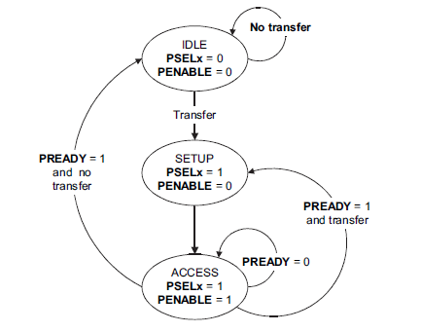
APB Protocol –Operating states
The figure bellow describes the operating states of the protocol:

Slide 24
APB Protocol – operating states
The state machine operates through the following states:
IDLE - This is the default state of the APB.
SETUP - When a transfer is required the bus moves into the SETUP state, where the appropriate select signal, PSELx, is asserted. The bus only remains in the SETUP state for one clock cycle and always moves to the ACCESS state on the next rising edge of the clock.
ACCESS - The enable signal, PENABLE, is asserted in the ACCESS state. The
address, write, select, and write data signals must remain stable during
the transition from the SETUP to ACCESS state. Exit from the ACCESS state is controlled by the PREADY signal from the slave:
• If PREADY is held LOW by the slave then the peripheral bus remains in the ACCESS state.
• If PREADY is driven HIGH by the slave then the ACCESS state is exited and the bus returns to the IDLE state if no more transfers are required. Alternatively, the bus moves directly to the SETUP state if another transfer follows.

Slide 25
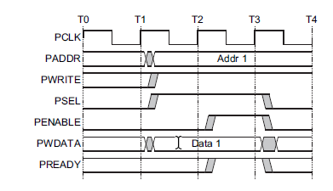
APB Protocol – write transaction
In Figure attached there is an example of write transaction with no wait states can be seen, with the first cycle of the transfer being from T1 to T2 and the second cycle from T2 to T3.

Slide 26
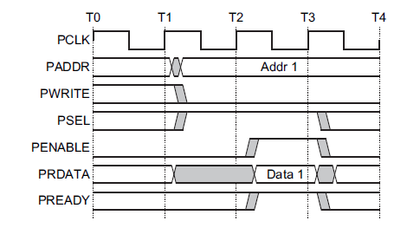
APB protocol – read transaction
In Figure attached an example of write transaction with no wait states can be seen, with the first cycle of the transfer being from T1 to T2 and the second cycle from T2 to T3.

Slide 27
K means core

Slide 28
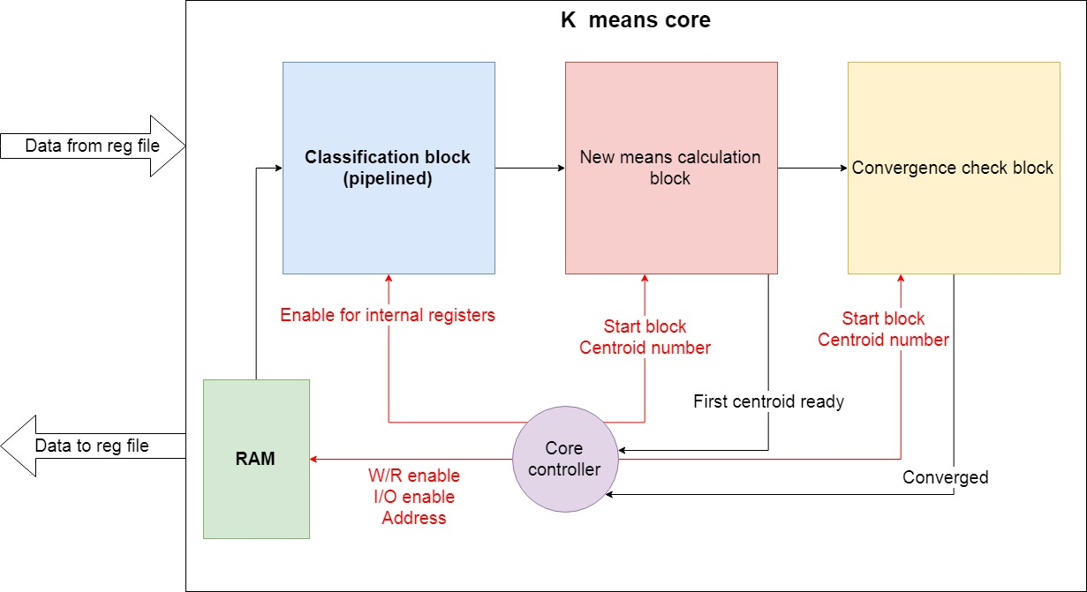
K means core
The proposed architecture for the k means core block is as described in the figure attached. This block is responsible for running the k means algorithm. It receives the input data points from the register file block by indirect access, as well as the initial centroids. The block output (to the register file block) is the final centroids value after the algorithm has ended and an interrupt indicating the calculation has been finished.

Slide 29
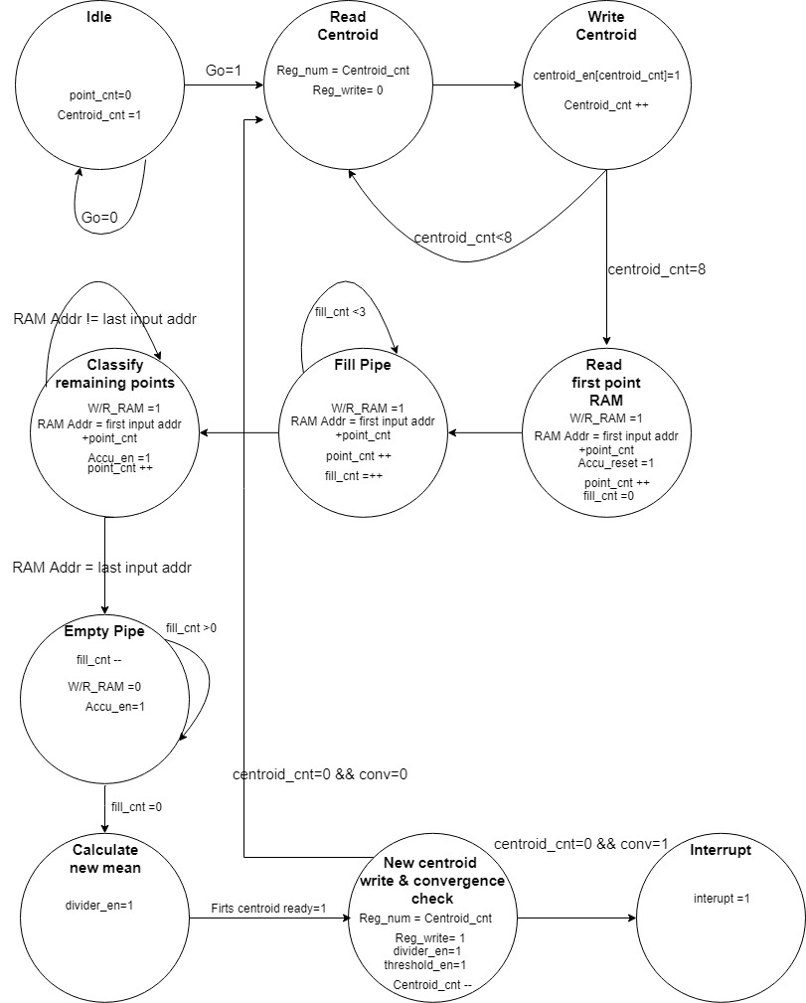
K means core: controller state machine
The k means core controller is a state machine who controls the core setting signals connected to the other blocks in the core and to the register file block.

Slide 30
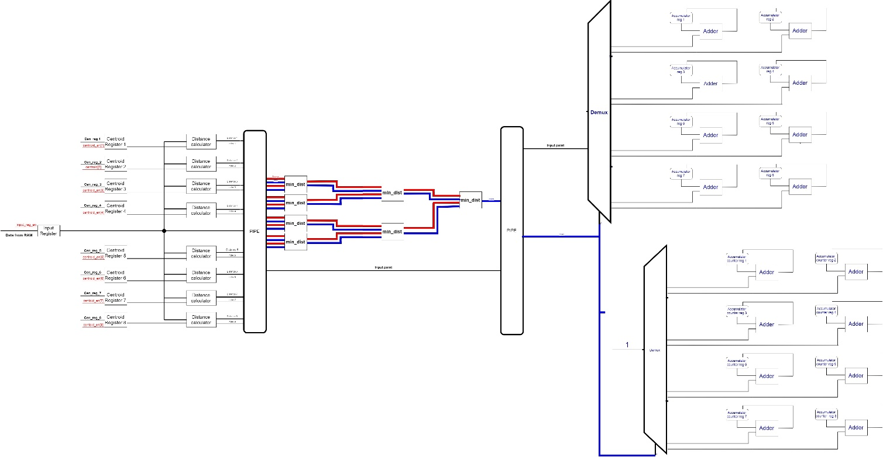
K means core: Classification block
The “Classification block” is a pipelined component which classifies the input data points into cluster by adding the data point to one of eight registers called “Accumulator X register” (X is an integer from 1 to 8). It has a throughput of one data point per cycle (after each cycle, one data point is added to the correct accumulator) but it has a latency of four cycles(one for reading the data from the RAM, one for calculating the distance between the centroid and the point, one to determine to closest centroid and one for adding to point to the accumulator.

Slide 31
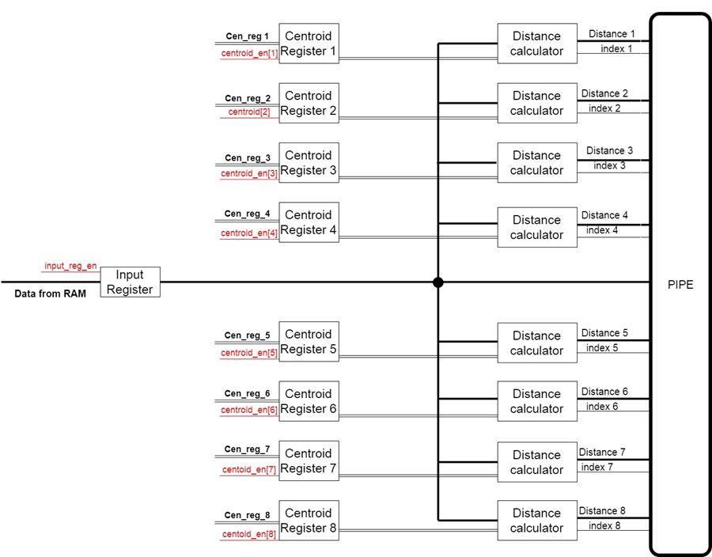
K means core: Classification block first part
The distance calculation from the input data point (stored in the “Input register”) to the centroids, which are stored in local registers called “Centroid Register X” (X being a integer from 1 to 8). This calculation is done by o module called “Distance calculator” which is basically two sub modules in series: the first calculates the subtraction of the data in the input register from the data in centroid register “X”, the second is a module which calculates the absolute value of the mentioned subtraction.

Slide 32
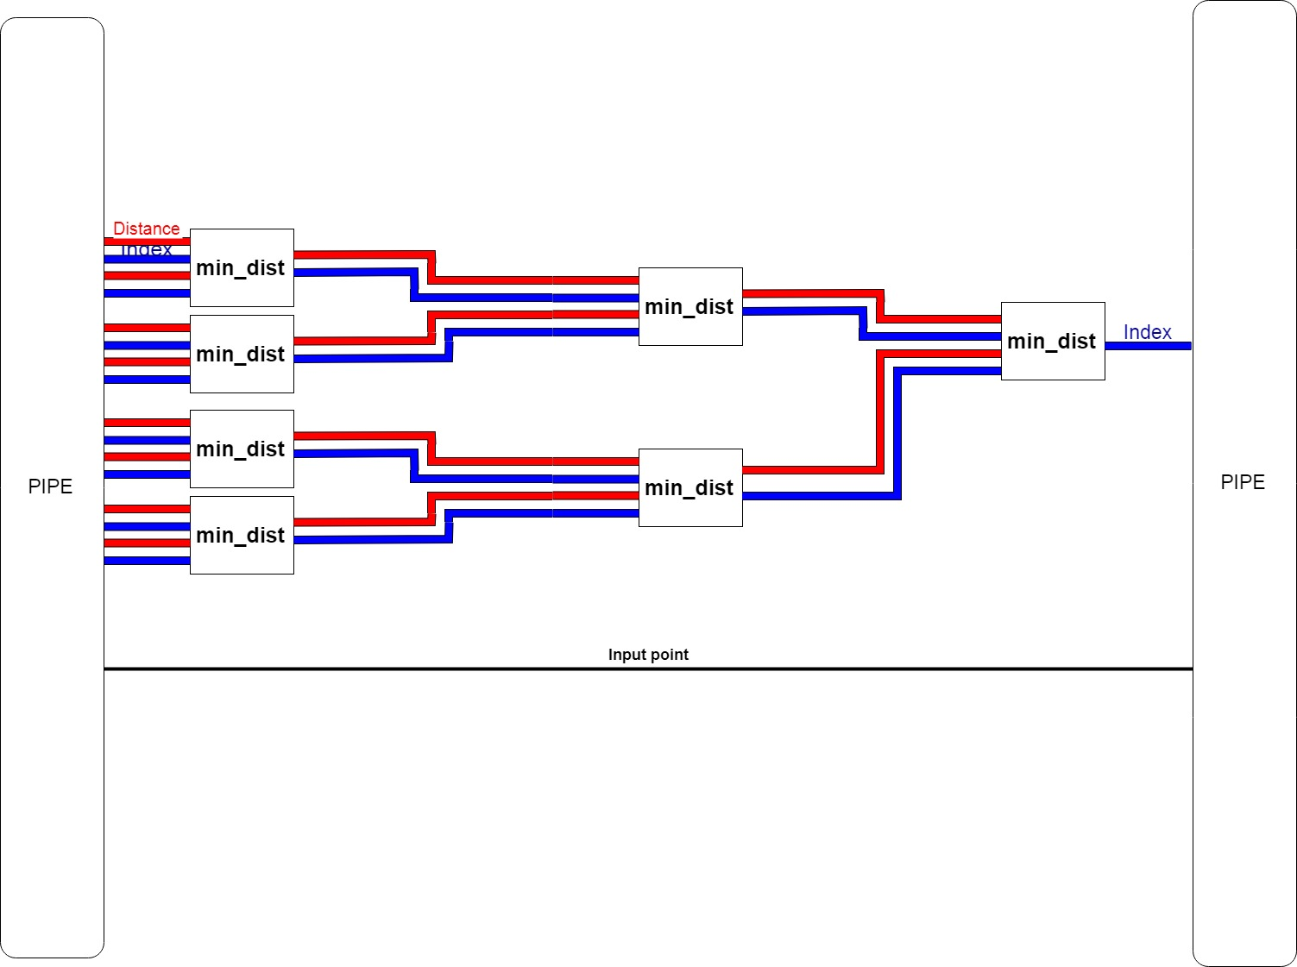
K means core: Classification block second part
The second part is the minimum distance calculation. In this part, all the distances from the first are compared, and in the index of the closest centroid is found and given as output of this block

Slide 33
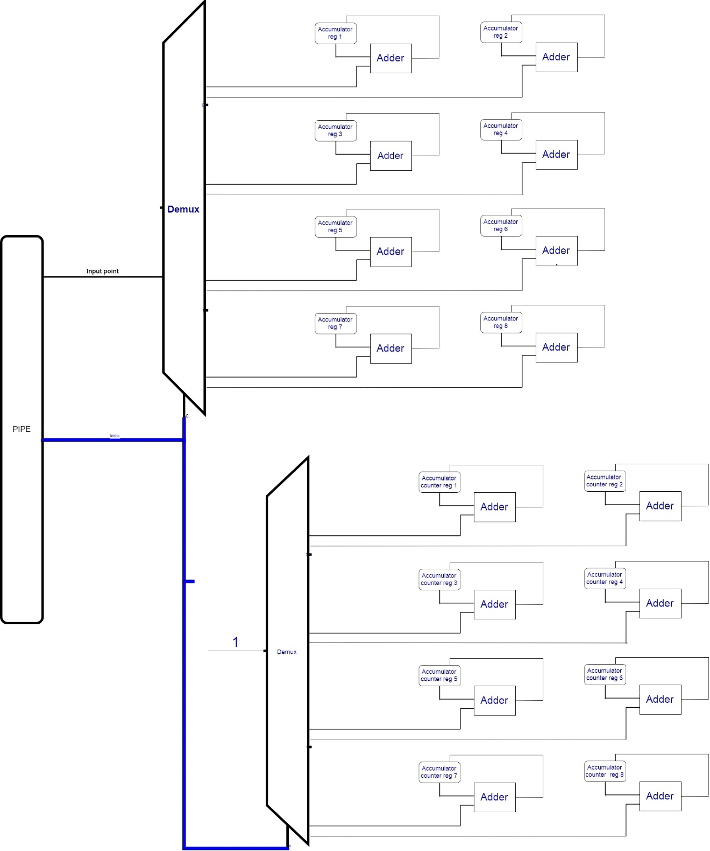
K means core: Classification block third part
The third and final part of the Classification block pipeline is the accumulation of the input data point in the desired accumulator register, chosen by the index received from second part. In this part, there are sixteen registers: eight accumulators registers and eight counters registers. Each accumulator represents a cluster and stores the summed of all points assign to this cluster at a given time. The counters are register which simply keep track of how many points were assigned to each cluster. The index received from the previous part is used as a selector for two decoders, in order to choose to each accumulator, register and counter register the input data point should be added.

Slide 34
K means core: new means calculation block - Division method
Duo to the complexity and time demanding characteristics of the floating point representation, the proposed architecture works with the fixed point representation. Therefore, there was a need to find a proper way to divide fixed point values.
The proposed method was to convert the fixed point number to an integer by shifting all fractional bits left (multiplying by 1024 ), dividing the converted number by using an integer divider(with known an simple algorithms, as describe in section Division in Hardware in the project report), and after the division shifting right the result in order to return to the fixed point representation.

Slide 35
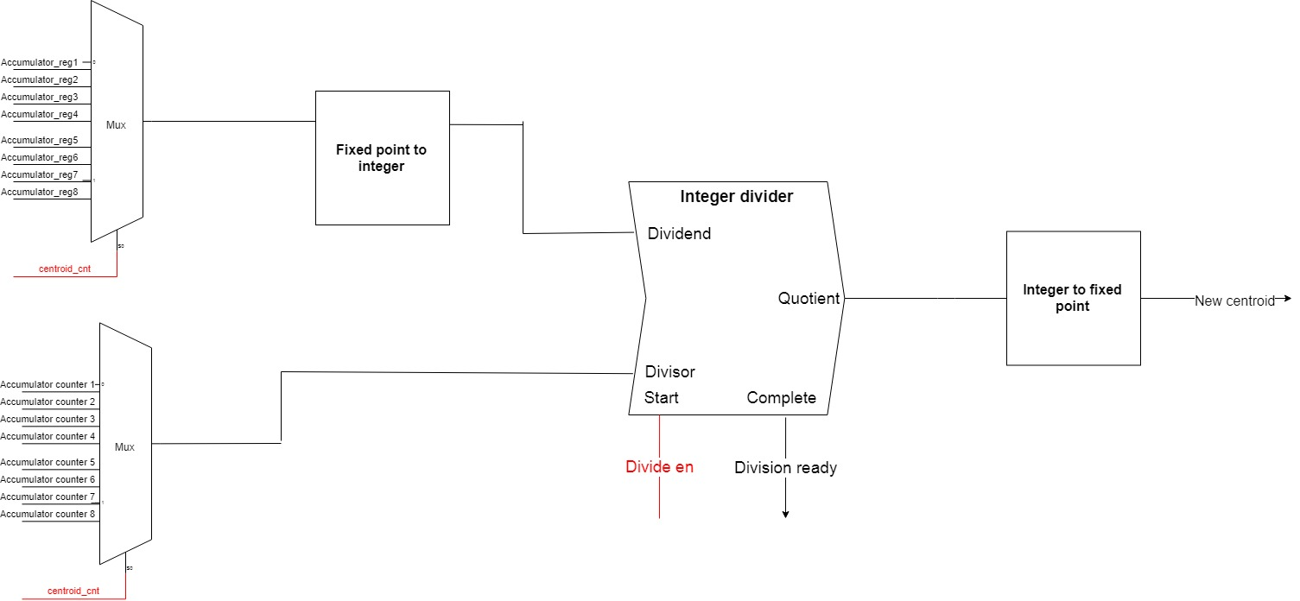
K means core: New means Calculation block
The “New Means Calculation block” is responsible for centroids update step of the algorithm. It does so by dividing the value of each accumulator(stored at the local “Accumulator reg” register in the “Classification block”) by the number of points assigned to them(stored at the local “Accumulator counter reg” register in the “Classification block”).

Slide 36
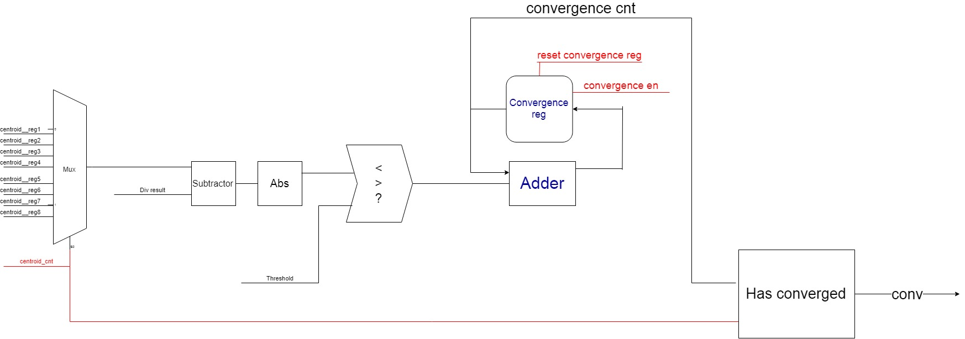
K means core: Convergence check block
The convergence check block is responsible for the convergence check step of the algorithm. It does so by checking if any of the new centroids calculated in the “New Means Calculation block” value is close enough (within a pre-decided threshold stored at “Threshold register ” in the register file) to its old value(the value stored in the beginning of the iteration, stored in local registers of the classification block).

Slide 37
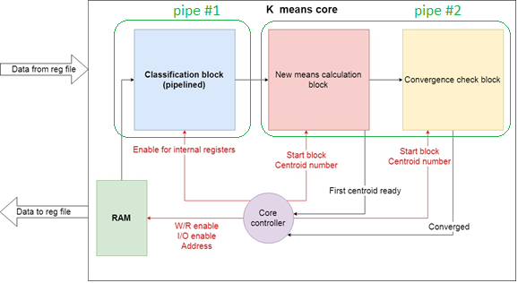
Why this architecture?
K means core pipeline view is divided into two pipelines, the division can be seen in the figure attached. The reason for this division is the Read-After-Write dependency between the 2 pipes. This results by having one pipe working while the other wait for it's results. The left pipe result is all data points classified to clusters, which then can be used to calculate the new means for next iteration (or the last means if there will be a convergence). Then for the next iteration of classifying the data points, the new means value has to be ready, therefore the first pipe will "sleep" until second pipe will finish bringing the result of calculating new means

Slide 38
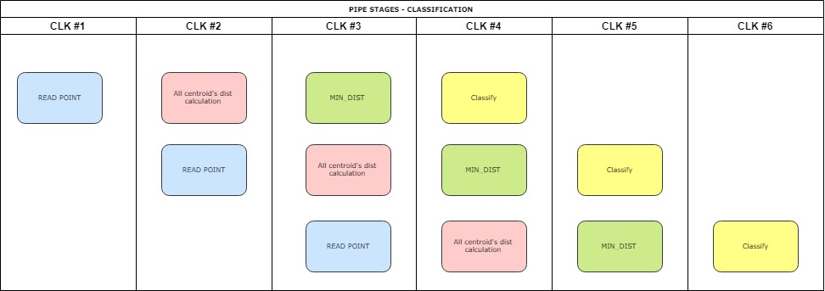
First Pipeline

Slide 39

First PIPELINE latency
The latency of the first pipeline is the number of cycles to fill the pipeline, plus the amount of data points(duo to the fact that after filled, it has a throughput of 1 data point processed per cycle) plus the number of cycles to empty the pipeline:
$$latency_{pipe1}=3+\left(number of points\right)+3$$

Slide 40

First PIPELINE THROUGHPUT
The throughput of the first pipeline, after neglecting the fill & empty of the pipe as seen in the former slide, will be classifying one data point per cycle(there are 4 in the pipe at each situation and pipe width is 4 as well).
The bandwidth therefore can calculated as point_size_in_Bytes/clk_cycle.
Example:
point_size_in_Bytes = 10 [Bytes].
Clk cycle = 2[ns]
Bandwidth = ${0.5∗10}^{10}\left[\frac{Bytes}{sec}\right] \text{=} 5\left[\frac{GB}{sec}\right]$

Slide 41
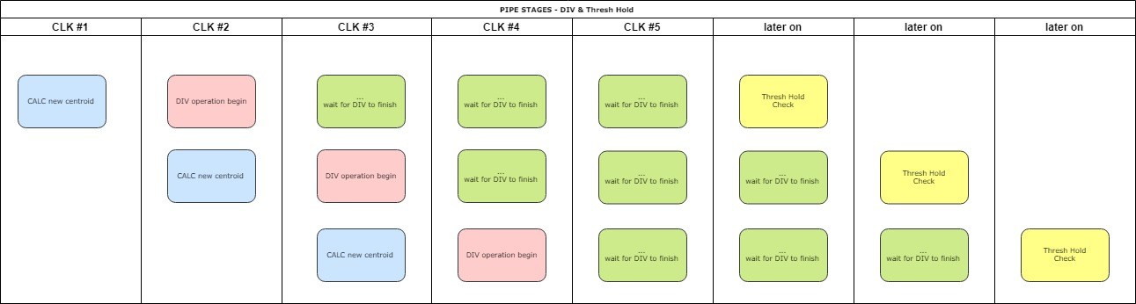
Second Pipeline

Slide 42

Second PIPELINE latency
The latency of the second pipeline eight times the number of cycle to calculate the division for the new centroid(2), plus the number of cycles to check the convergence of a centroid(1), and at the one extra cycle at the end:
$$latency_{pipe2}=8∗\left(2+1\right)+1$$

Slide 43

Second PIPELINE throughput
The throughput of the second pipeline is addressed by the need of 2 cycles for each division operation and one cycle for convergency check, therefore every 3 clk cycles there will be finished a decision regarding a new centroid’s convergency.
The bandwidth therefore can calculated as centroid_size/(3*clk_cycle).Example:
centroid_size (in_Bytes) = 10 [Bytes].
Clk cycle = 2[ns]
Bandwidth =$\frac{{10}^{10}}{6}\left[\frac{Bytes}{sec}\right]≈1.67\left[\frac{GB}{sec}\right]$

Slide 44

Total PIPELINE latency
Finaly, one iteration of the algorithm latency results in:
$$latency_{iteration}=lantency_{pipe1}+latency_{pipe2}$$
The overall latency of the k means core will therefore be:
$$latency_{total}=latency_{iteration}∗(number of iterations)$$

Slide 45
Verification

Slide 46
Zero order verification
The plan for verification is to build testbenches who will insert an input to the architecture a preset data set and compare the results with the data set in Matlab version of the algorithm.
Description | Test Bench Type
Make sure the hardware works – put a simple example that supposed to converge fast | Sanity
Put inside an already converged data & centroids, make sure nothing changes, only one iteration required | Do Nothing
Check latency & throughput for variant sizes of inputs. | Performance
Hypothetical(not in our project) – let the randomization challenge our design, as done in the industry. | Random

Slide 47
Next steps:
Code in System Verilog the architecture : Register File and K means core
To write a test bench to verify the architecture
Zero order verification
Synthesis
Finish the project report

Slide 48
Thank you

